Slide 1
DS PROJECT
POLYNOMIAL ADDITION [ using LINKEDLIST]

Slide 2
Real life applications:
->polynomials are used in physics to describe the
trajectory of projectiles.
->people use them in the real world to graph curves.
->Engineers use polynomials to graph the curves of
roller coasters and bridges.
->Business people also use polynomials to model
markets, as in to see how raising the price of a good
will affect its sales.

Slide 3
To develop program code:
Control statements If, switch case
Looping statements
For , while/do while
Pointers
Linked Lists
Structures

Slide 4
MODULES:
In developing this code we used 3 modules:
->create
->add
->display
These three modules gives the output of the project as per the prepared manner.

Slide 5
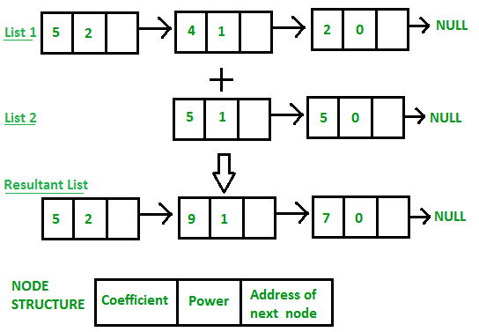
Polynomial representation using linked list:
poly1 NULL
poly2 NULL
poly NULL
Coeff
pow
Address of next

Slide 6
DESCRIPTION:
->For adding two polynomials that are stored as a linked list.
We need to add the coefficients of variables with the same
power.
->In a linked list node contains 3 members, coefficient value
link to the next node.
->Initialised head for all linked lists to NULL.
->Function to create new node.
->Function to add the polynomials.
->Function to display the result.

Slide 7
Structure used:
struct link
{
int coeff;
int pow;
struct link *next;
};

Slide 8
Functions:
void create; [void create(struct link *node)]
void void show; [void show(struct link *node)]
void polyadd;
Parameters:
->poly1
->poly2
->poly
void polyadd(struct link *poly1,struct link *poly2,struct link
*poly)

Slide 9
Adding the polynomials:
->If power of 1st polynomial is greater then 2nd, then store
1st as it is and move its pointer.
->If power of 2nd polynomial is greater then 1st, then store
2nd as it is and move its pointer.
->If power of both polynomial numbers is same then add
their coefficients.
->Dynamically create new node.

Slide 10
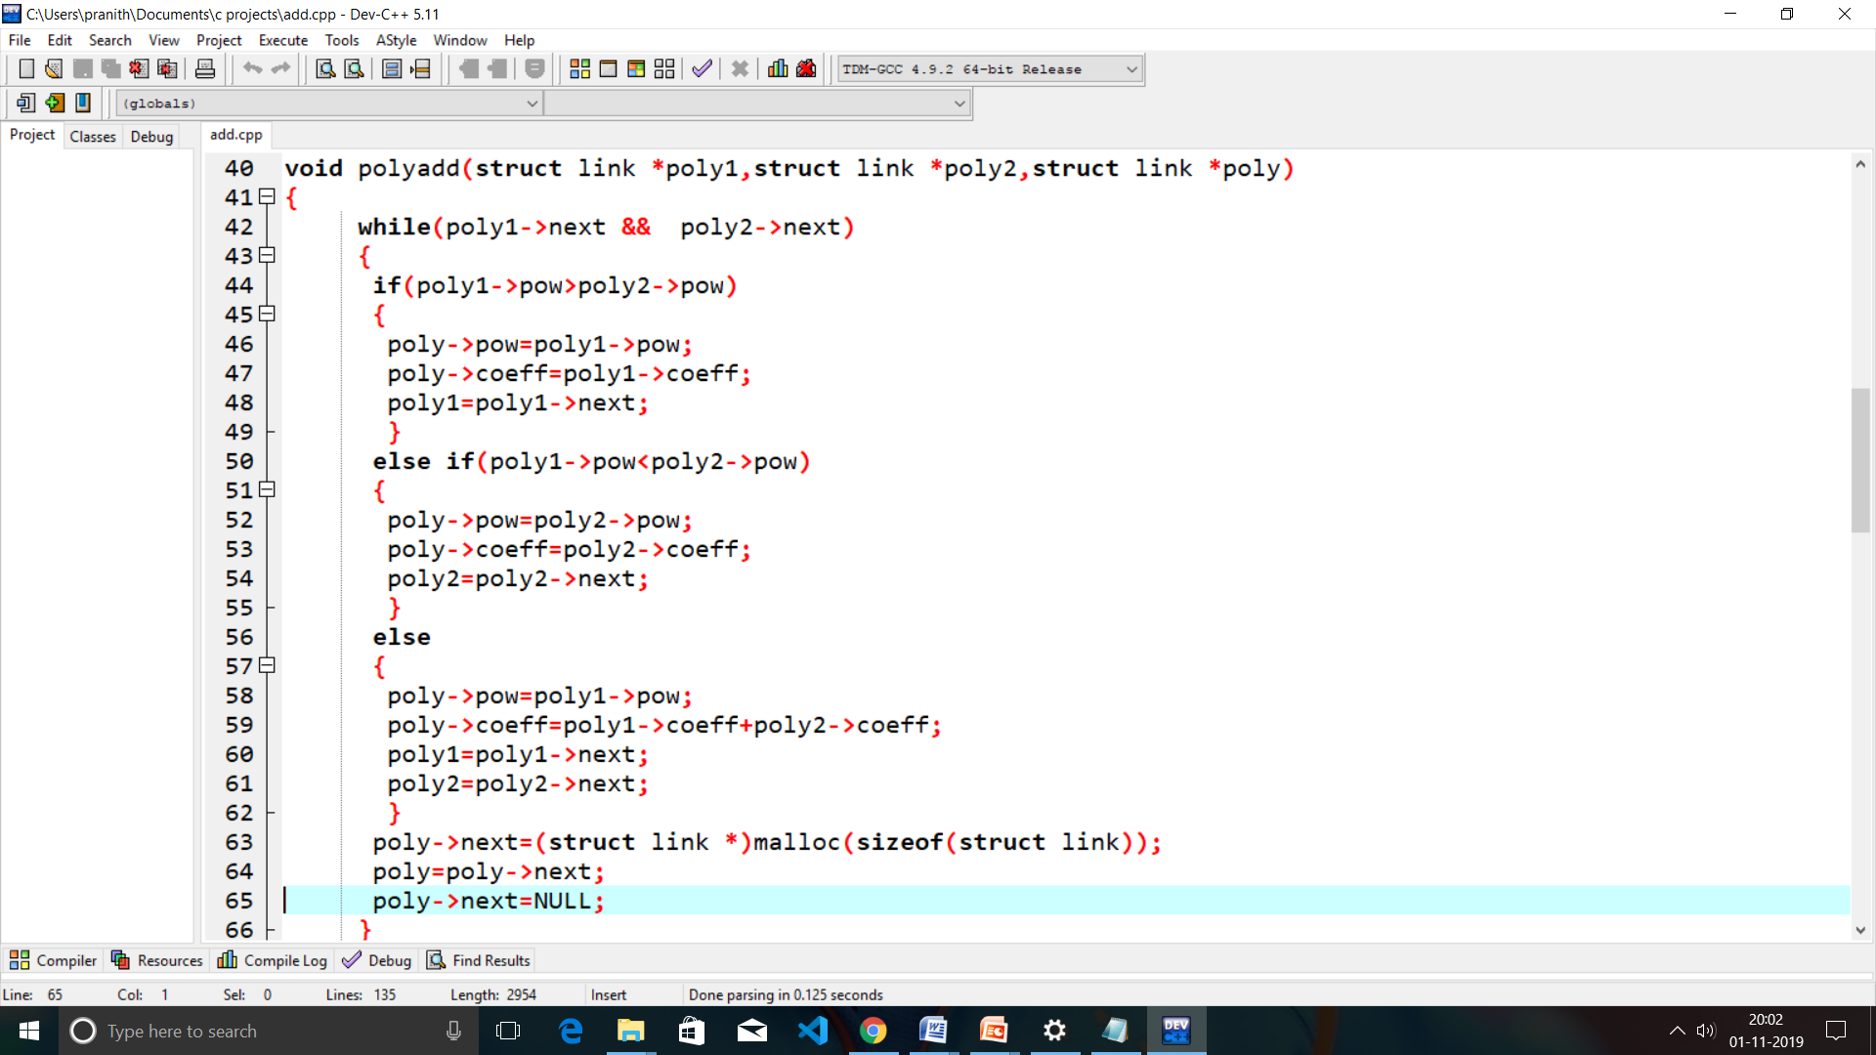

Slide 11
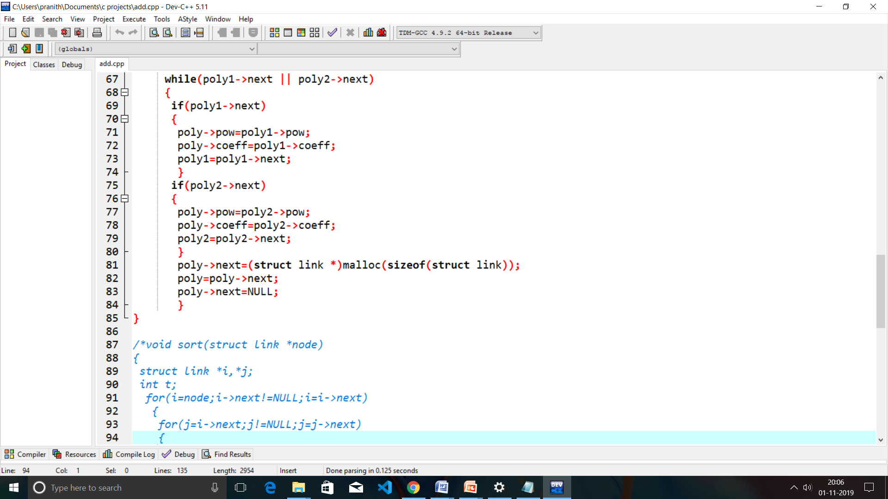

Slide 12
Display Function:
void show(struct link *node)
{
while(node->next!=NULL)
{
printf("%d(x^%d)",node->coeff,node->pow);
node=node->next;
if(node->next!=NULL && node->coeff>=0)
printf("+");
}
}

Slide 13
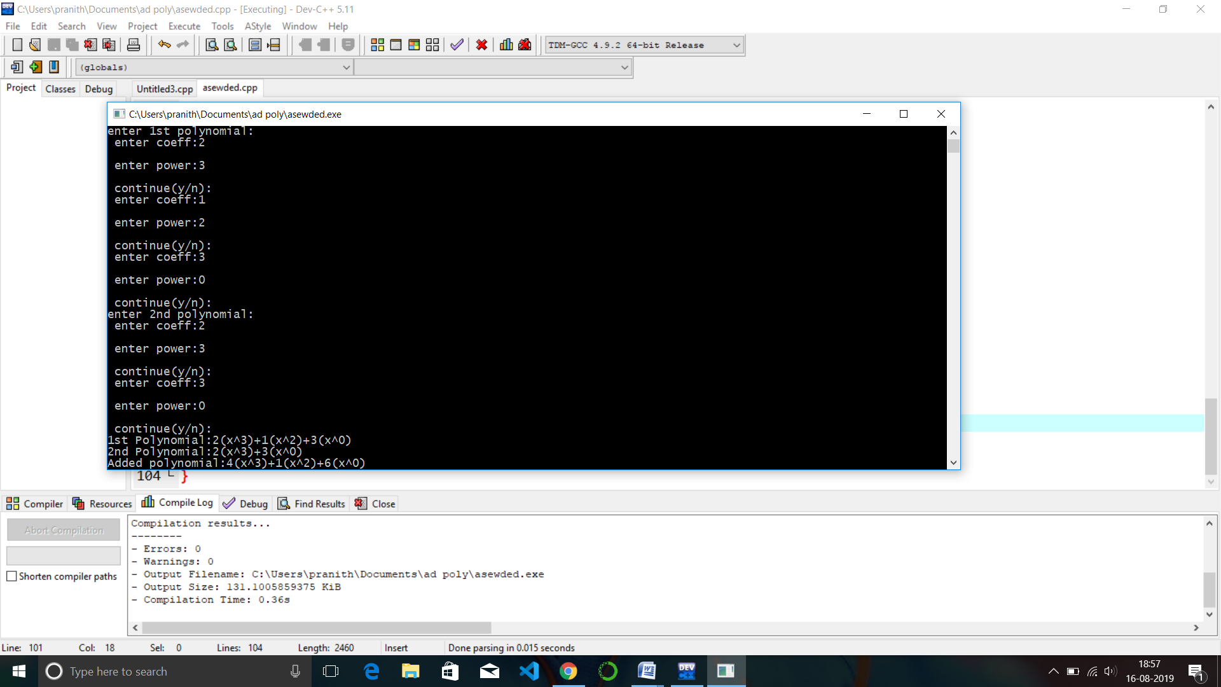
Results:

Slide 14
THANK YOU....

